Slide 1

Crafting Game Feel
Michael Baker

Slide 2






Crafting Game Feel - Michael Baker - michael.baker@austin.utexas.edu
Notes:
Projects and brands I’ve worked with

Slide 3
Defining Game Feel
(for action games)
Crafting Game Feel - Michael Baker - michael.baker@austin.utexas.edu
Proprioception & Kinesthetics - sense of body motion ref: Errant Signal - Kinesthetics
Game Feel - sense of weight, friction, momentum ref: Game Feel by Steve Swink and Secrets of Game Feel and Juice by Mark Brown
Principles of Animation squash & stretch, anticipation, overlapping action, exaggeration

Slide 4
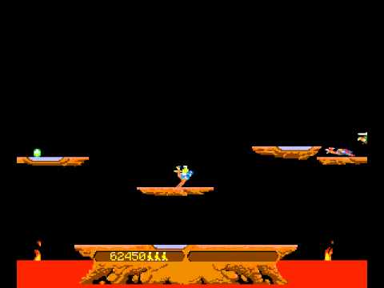
Crafting Game Feel - Michael Baker - michael.baker@austin.utexas.edu

Slide 5
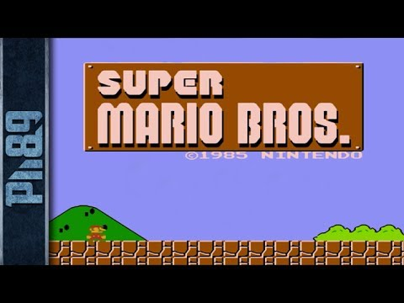
Crafting Game Feel - Michael Baker - michael.baker@austin.utexas.edu

Slide 6
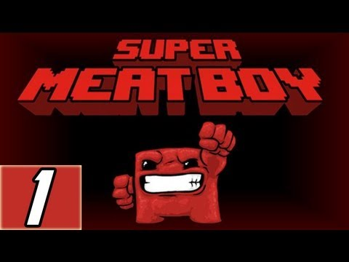
Crafting Game Feel - Michael Baker - michael.baker@austin.utexas.edu

Slide 7
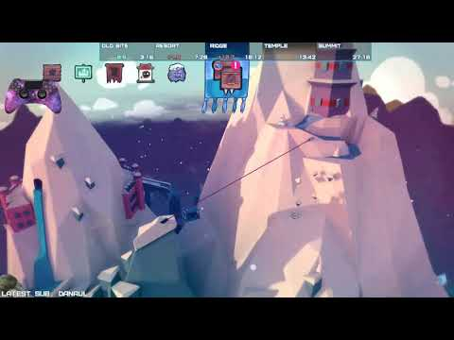
Crafting Game Feel - Michael Baker - michael.baker@austin.utexas.edu

Slide 8
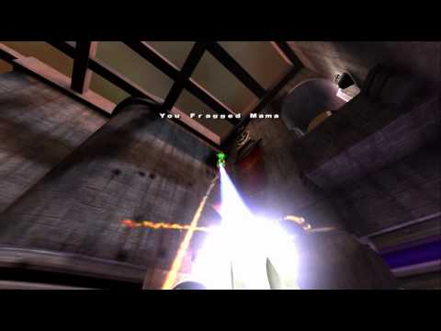
Crafting Game Feel - Michael Baker - michael.baker@austin.utexas.edu

Slide 9
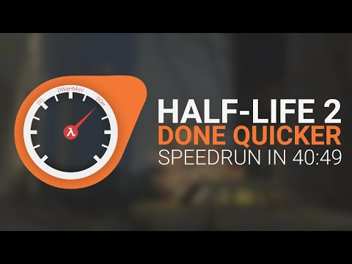
Crafting Game Feel - Michael Baker - michael.baker@austin.utexas.edu

Slide 10
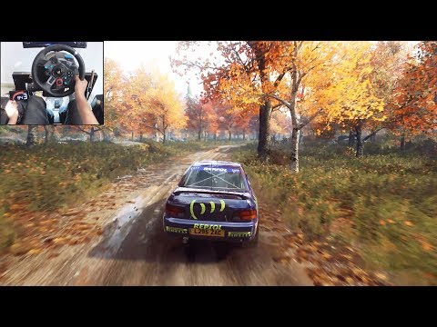
Crafting Game Feel - Michael Baker - michael.baker@austin.utexas.edu

Slide 11
Demo
Crafting Game Feel - Michael Baker - michael.baker@austin.utexas.edu

Slide 12
Level Design Tips
Crafting Game Feel - Michael Baker - michael.baker@austin.utexas.edu
Hide settings from designers
Avoid adding features try to solve problems with art beware “wouldn’t it be cool if…”
Set up playgrounds to find the fun

Slide 13
Thank You
Crafting Game Feel - Michael Baker - michael.baker@austin.utexas.edu

